Slide 1
Comparing searching algorithms
Mack 2022
Notes:
Last updated: 12-2-2022

Slide 2

Searching for a word
Starter activity
You are looking for a word in a dictionary that starts with “ca”. A sample of the data is shown below:
Questions:
Which of the searching algorithms can you use on this data?
What is meant by the worst-case scenario?
Give an example of a worst-case scenario from this data.
Think, write, pair, share.
Cabin | Cable | Cabot | Cacao | Cache | Cacti | Cactus | Cadet

Slide 3

Lesson 48: Comparing searching algorithms
Objectives
In this lesson, you will:
Compare the features of linear and binary search and decide which is most suitable in a given context
Interpret the code for linear search and binary search
Trace code for both searching algorithms with input data

Slide 4

Comparing linear and binary search
Activity 1
So far, you have performed linear and binary searches separately to find an item in a list.
You have also considered the worst-case scenario of both of these algorithms i.e. the most number of comparisons possible on a given list of data.
It is important you can describe the differences between these two searching algorithms so that you can recognise when one algorithm might be more suitable than another.

Slide 5

Comparing linear and binary search
Activity 1
 | Linear search | Binary search
Ordered data
Number of comparisons
Simplicity of the algorithm
The sequence of items in the list can either be ordered or unordered.
The sequence of items in the list must be ordered.
In the worst-case scenario, every item in the list is compared to the search item.
If you double the amount of items in the list, then the maximum number of comparisons will also double.
Every single comparison to the search item removes half the items in the list.
If you double the number of items in the list, you will need at most one more comparison.
The algorithm is simpler to write.
The algorithm is longer and more complex to write.

Slide 6
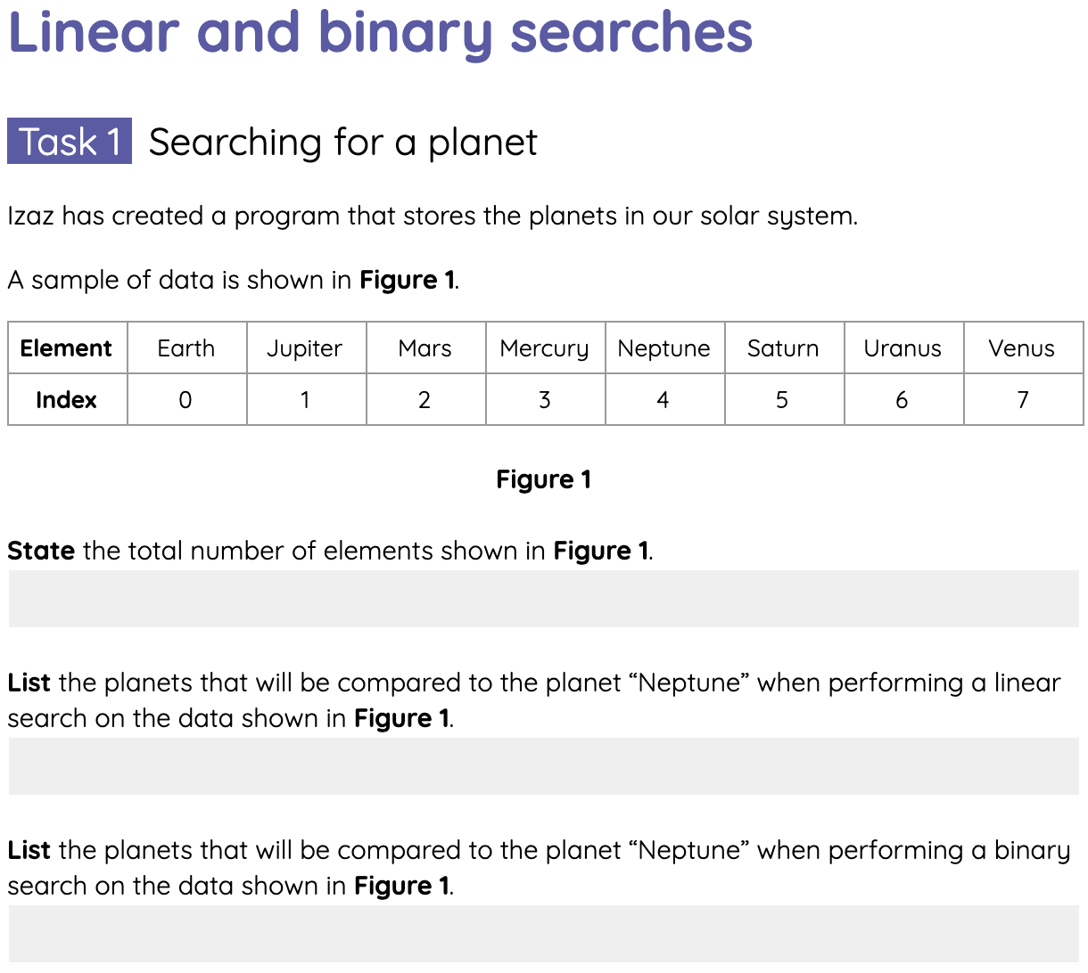
Linear and binary searches
Activity 2
Next, you will see some of those differences in practice.
Complete the tasks on the Activity 2 worksheet for performing linear and binary searches.

Slide 7
Code for linear search
Activity 3
def linear_search( ):
Define a new function for linear search

Slide 8
Code for linear search
Activity 3
def linear_search( ):
Question What input data is needed for the algorithm’s parameters?

Slide 9
Code for linear search
Activity 3
def linear_search(items, search_item):
Question What input data is needed for the algorithm’s parameters?
Answer The algorithm receives a list of items and the search item as parameters.

Slide 10
Code for linear search
Activity 3
def linear_search(items, search_item):
index = -1
current = 0
found = False
Initialise the variables
index stores the index of the found item. The value -1 signifies the item has not been found.
current stores the index of the current item in the list. The value 0 means it will start from the first item in the list.
found is a flag that is used to record if the search item has been found or not.

Slide 11
Code for linear search
Activity 3
def linear_search(items, search_item):
index = -1
current = 0
found = False
if :
Compare the current item to the item you are searching for
Question What is the condition of the selection statement?

Slide 12
Code for linear search
Activity 3
def linear_search(items, search_item):
index = -1
current = 0
found = False
if items[current] == search_item:
Compare the current item to the item you are searching for

Slide 13
Code for linear search
Activity 3
def linear_search(items, search_item):
index = -1
current = 0
found = False
if items[current] == search_item:
index = current
found = True
if the item has been found, store the current index and raise the flag.

Slide 14
Code for linear search
Activity 3
def linear_search(items, search_item):
index = -1
current = 0
found = False
while :
if items[current] == search_item:
index = current
found = True
The selection statement is placed inside a loop, so that the items in the list are checked, one after the other.

Slide 15
Code for linear search
Activity 3
def linear_search(items, search_item):
index = -1
current = 0
found = False
while :
if items[current] == search_item:
index = current
found = True
current = current + 1
Proceed to the next item in the list
Move the current index onto the next element in the list by incrementing the value of current by 1

Slide 16
Code for linear search
Activity 3
def linear_search(items, search_item):
index = -1
current = 0
found = False
while :
if items[current] == search_item:
index = current
found = True
current = current + 1
Repeat while the end of the list has not been reached and the search item has not been found.
Question What is the condition of the while loop?

Slide 17
Code for linear search
Activity 3
def linear_search(items, search_item):
index = -1
current = 0
found = False
while current < len(items) and found == False:
if items[current] == search_item:
index = current
found = True
current = current + 1
Repeat while the end of the list has not been reached and the search item has not been found.

Slide 18
Code for linear search
Activity 3
def linear_search(items, search_item):
index = -1
current = 0
found = False
while current < len(items) and found == False:
if items[current] == search_item:
index = current
found = True
current = current + 1
Question What should happen once the end of the list is reached?
Hint: this is a function, not a procedure.

Slide 19
Code for linear search
Activity 3
def linear_search(items, search_item):
index = -1
current = 0
found = False
while current < len(items) and found == False:
if items[current] == search_item:
index = current
found = True
current = current + 1
return index
Return the index where the search item was found

Slide 20
Code for linear search
Activity 3
def linear_search(items, search_item):
index = -1
current = 0
found = False
while current < len(items) and found == False:
if items[current] == search_item:
index = current
found = True
current = current + 1
return index
Question What value is returned if the search item has not been found?

Slide 21
Code for linear search
Activity 3
def linear_search(items, search_item):
index = -1
current = 0
found = False
while current < len(items) and found == False:
if items[current] == search_item:
index = current
found = True
current = current + 1
return index
Question What value is returned if the search item has not been found?
Answer The initial value of -1 indicates that the item has no been found.

Slide 22

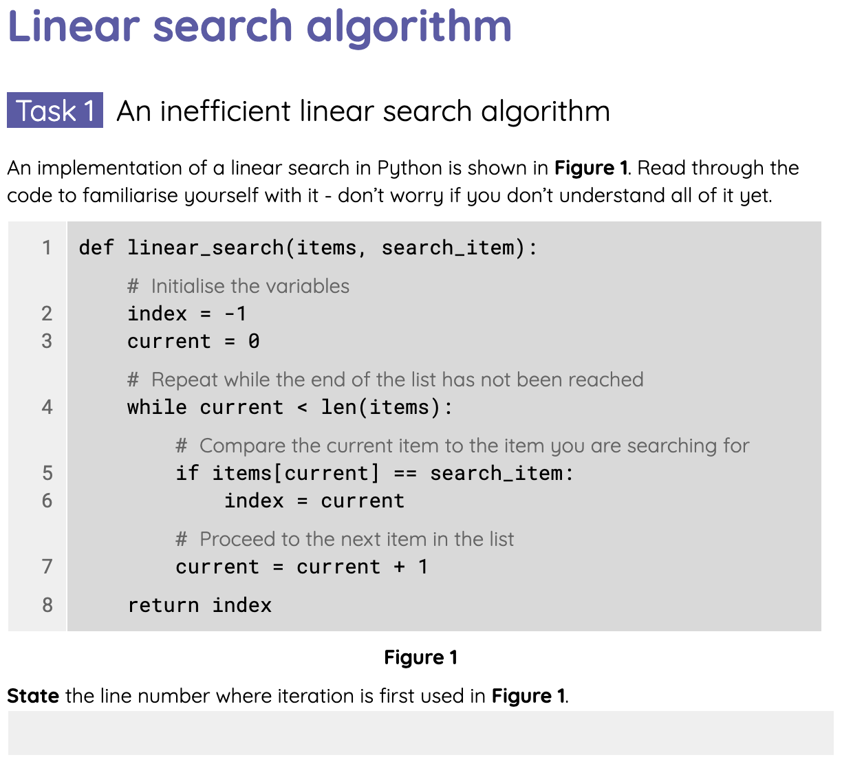
Code for linear search
Activity 3
The next worksheet contains two versions of the linear search algorithm written in Python.
Complete the tasks on the Activity 3 worksheet.

Slide 23
Code for binary search
Activity 4
def binary_search( ):
Define a new function for binary search

Slide 24
Code for binary search
Activity 4
def binary_search( ):
Question What input data is needed for the algorithm’s parameters?

Slide 25
Code for binary search
Activity 4
def binary_search(items, search_item):
Question What input data is needed for the algorithm’s parameters?
Answer The algorithm receives a list of items and the search item as parameters.

Slide 26
Code for binary search
Activity 4
def binary_search(items, search_item):
index = -1
first = 0
last = len(items) - 1
found = False
Initialise the variables
index stores the index of the found item. The value -1 signifies the item has not been found.
first and last store the indices of the first and the last items in the list, where the search item might be found.
found is a flag that is used to record if the search item has been found or not.

Slide 27
Code for binary search
Activity 4
def binary_search(items, search_item):
index = -1
first = 0
last = len(items) - 1
found = False
midpoint = (first + last) // 2
Find the middle item (midpoint) between first and last
Add the first and last values together and calculate the floor division of the total by 2.
e.g. (0 + 9) // 2 equals 4
If the number of items from the first to the last is even, the midpoint is the middle-left item.

Slide 28
Code for binary search
Activity 4
def binary_search(items, search_item):
index = -1
first = 0
last = len(items) - 1
found = False
midpoint = (first + last) // 2
if :
Compare the item at the midpoint to the item you are searching for
Question What is the condition of the selection statement?

Slide 29
Code for binary search
Activity 4
def binary_search(items, search_item):
index = -1
first = 0
last = len(items) - 1
found = False
midpoint = (first + last) // 2
if items[midpoint] == search_item:
Compare the item at the midpoint to the item you are searching for

Slide 30
Code for binary search
Activity 4
def binary_search(items, search_item):
index = -1
first = 0
last = len(items) - 1
found = False
midpoint = (first + last) // 2
if items[midpoint] == search_item:
index = midpoint
found = True
if the item has been found, store the midpoint (i.e. the location it was found) and raise the flag.

Slide 31
Code for binary search
Activity 4
def binary_search(items, search_item):
index = -1
first = 0
last = len(items) - 1
found = False
midpoint = (first + last) // 2
if items[midpoint] == search_item:
index = midpoint
found = True
elif :
Otherwise, check if the item at the midpoint is lower than the search item.
Question What is the condition of the selection statement?

Slide 32
Code for binary search
Activity 4
def binary_search(items, search_item):
index = -1
first = 0
last = len(items) - 1
found = False
midpoint = (first + last) // 2
if items[midpoint] == search_item:
index = midpoint
found = True
elif items[midpoint] < search_item:
Otherwise, check if the item at the midpoint is lower than the search item.

Slide 33
Code for binary search
Activity 4
def binary_search(items, search_item):
index = -1
first = 0
last = len(items) - 1
found = False
midpoint = (first + last) // 2
if items[midpoint] == search_item:
index = midpoint
found = True
elif items[midpoint] < search_item:
first = midpoint + 1
Focus on the items that are larger than the midpoint by setting the first index to just after the midpoint index

Slide 34
Code for binary search
Activity 4
def binary_search(items, search_item):
index = -1
first = 0
last = len(items) - 1
found = False
midpoint = (first + last) // 2
if items[midpoint] == search_item:
index = midpoint
found = True
elif items[midpoint] < search_item:
first = midpoint + 1
else:
Otherwise, the item at the midpoint must be higher than the search item.

Slide 35
Code for binary search
Activity 4
def binary_search(items, search_item):
index = -1
first = 0
last = len(items) - 1
found = False
midpoint = (first + last) // 2
if items[midpoint] == search_item:
index = midpoint
found = True
elif items[midpoint] < search_item:
first = midpoint + 1
else:
last = midpoint - 1
Focus on the items that are smaller than the midpoint by setting the last index to just before the midpoint index

Slide 36
Code for binary search
Activity 4
def binary_search(items, search_item):
index = -1
first = 0
last = len(items) - 1
found = False
while :
midpoint = (first + last) // 2
if items[midpoint] == search_item:
index = midpoint
found = True
elif items[midpoint] < search_item:
first = midpoint + 1
else:
last = midpoint - 1
The statements are placed inside a loop, so that the process is repeated with the number of items between first and last being halved at each iteration.

Slide 37
Code for binary search
Activity 4
def binary_search(items, search_item):
index = -1
first = 0
last = len(items) - 1
found = False
while :
midpoint = (first + last) // 2
if items[midpoint] == search_item:
index = midpoint
found = True
elif items[midpoint] < search_item:
first = midpoint + 1
else:
last = midpoint - 1
Repeat while there are still items between first and last and the search item has not been found.
Question What is the condition of the while loop?

Slide 38
Code for binary search
Activity 4
def binary_search(items, search_item):
index = -1
first = 0
last = len(items) - 1
found = False
while first <= last and found == False:
midpoint = (first + last) // 2
if items[midpoint] == search_item:
index = midpoint
found = True
elif items[midpoint] < search_item:
first = midpoint + 1
else:
last = midpoint - 1
Repeat while there are still items to check between first and last and the search item has not been found.

Slide 39
Code for binary search
Activity 4
def binary_search(items, search_item):
index = -1
first = 0
last = len(items) - 1
found = False
while first <= last and found == False:
midpoint = (first + last) // 2
if items[midpoint] == search_item:
index = midpoint
found = True
elif items[midpoint] < search_item:
first = midpoint + 1
else:
last = midpoint - 1
Question What should happen when there are no more items to check?
Hint: this is a function, not a procedure.

Slide 40
Code for binary search
Activity 4
def binary_search(items, search_item):
index = -1
first = 0
last = len(items) - 1
found = False
while first <= last and found == False:
midpoint = (first + last) // 2
if items[midpoint] == search_item:
index = midpoint
found = True
elif items[midpoint] < search_item:
first = midpoint + 1
else:
last = midpoint - 1
return index
Return the index where the search item was found

Slide 41
Code for binary search
Activity 4
def binary_search(items, search_item):
index = -1
first = 0
last = len(items) - 1
found = False
while first <= last and found == False:
midpoint = (first + last) // 2
if items[midpoint] == search_item:
index = midpoint
found = True
elif items[midpoint] < search_item:
first = midpoint + 1
else:
last = midpoint - 1
return index
Question What value is returned if the search item has not been found?

Slide 42
Code for binary search
Activity 4
def binary_search(items, search_item):
index = -1
first = 0
last = len(items) - 1
found = False
while first <= last and found == False:
midpoint = (first + last) // 2
if items[midpoint] == search_item:
index = midpoint
found = True
elif items[midpoint] < search_item:
first = midpoint + 1
else:
last = midpoint - 1
return index
Question What value is returned if the search item has not been found?
Answer The initial value of -1 indicates that the item has no been found.

Slide 43
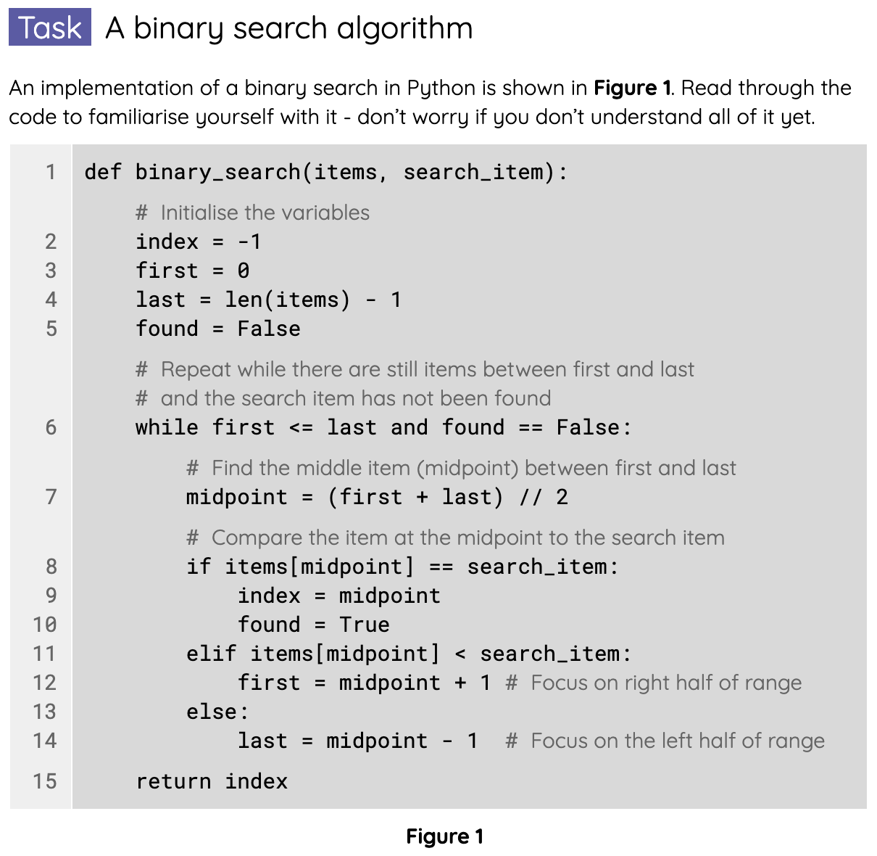
Code for binary search
Activity 4
The final worksheet is based on the binary search algorithm in Python.
Complete the tasks on the Activity 4 worksheet.

Slide 44

Summary of linear search and binary search
Wrap Up
 | Linear search | Binary search
Ordered data | The sequence of items in the list can either be ordered or unordered. | The sequence of items in the list must be ordered.
Number of comparisons | In the worst-case scenario, every item in the list is compared to the search item. If you double the amount of items in the list, then the maximum number of comparisons will also double. | Every single comparison to the search item removes half the items in the list. If you double the number of items in the list, you will need at most one more comparison.
Simplicity of the algorithm | The algorithm is simpler to write. | The algorithm is longer and more complex to write.

Slide 45
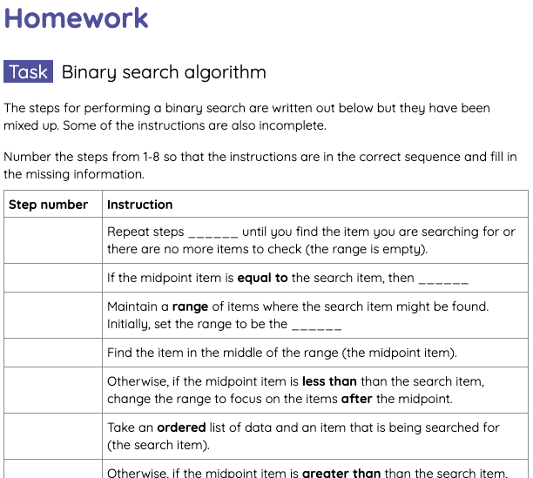
Homework: Binary search algorithm
Homework
You have been given the instructions for performing a binary search but they have been mixed up and some of them are also incomplete.
Number the steps so they are in the correct sequence and fill in the missing information.
Due: Next lesson

Slide 46
Next lesson
Summary
In this lesson, you…
Compared the features of linear and binary search and decide which was most suitable in a given context.
Interpreted the code for linear search and binary search.
Traced code for both searching algorithms with input data.
Next lesson, you will…
Explore one of the sorting algorithms, bubble sort.

